Slide 1
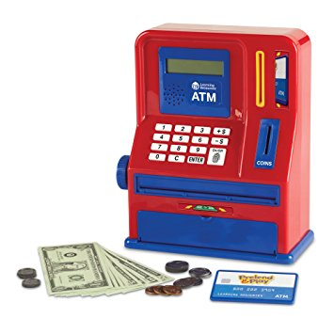
ATM Project
NEEDS MORE WORD ART
Mary Husain | Michal Porubcin | Andrew Quijano | Bryce Yoo
Notes:
Mary Husain
Michal Porubcin
Andrew Quijano
Bryce Yoo

Slide 2
Overview
Core Functionality
User Interface
Encryption
Database
Online ATM
User Accounts
Tools & Services
Paragraph (if not needed, delete)
Bullet
Dash
Subbullet
Paragraph (if not needed, delete)
Bullet
Dash
Subbullet
Paragraph (if not needed, delete)
Bullet
Dash
Subbullet

Slide 3
Core Functionality
User Accounts
First Name
Last Name
PIN Code
Account Balance
Services
Withdrawals
Multiples of $20
Quick withdrawal options from $20 - $100
Manual for amounts larger than $100
Deposits
Any positive amount (minimum $0.01)

Slide 4
User Interface

Slide 5
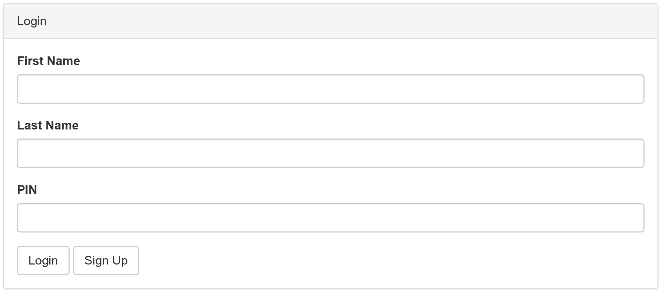
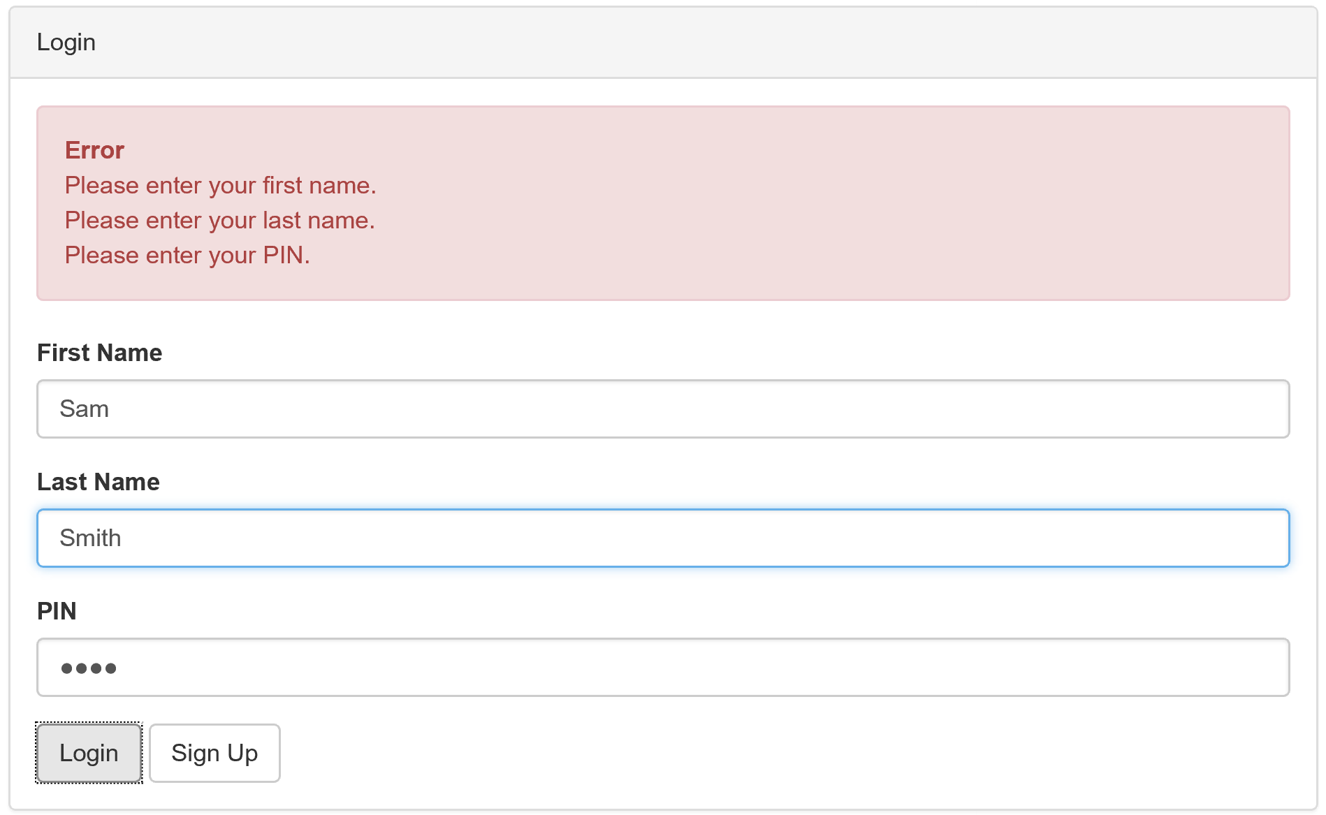
Login Screen and Validation

Slide 6
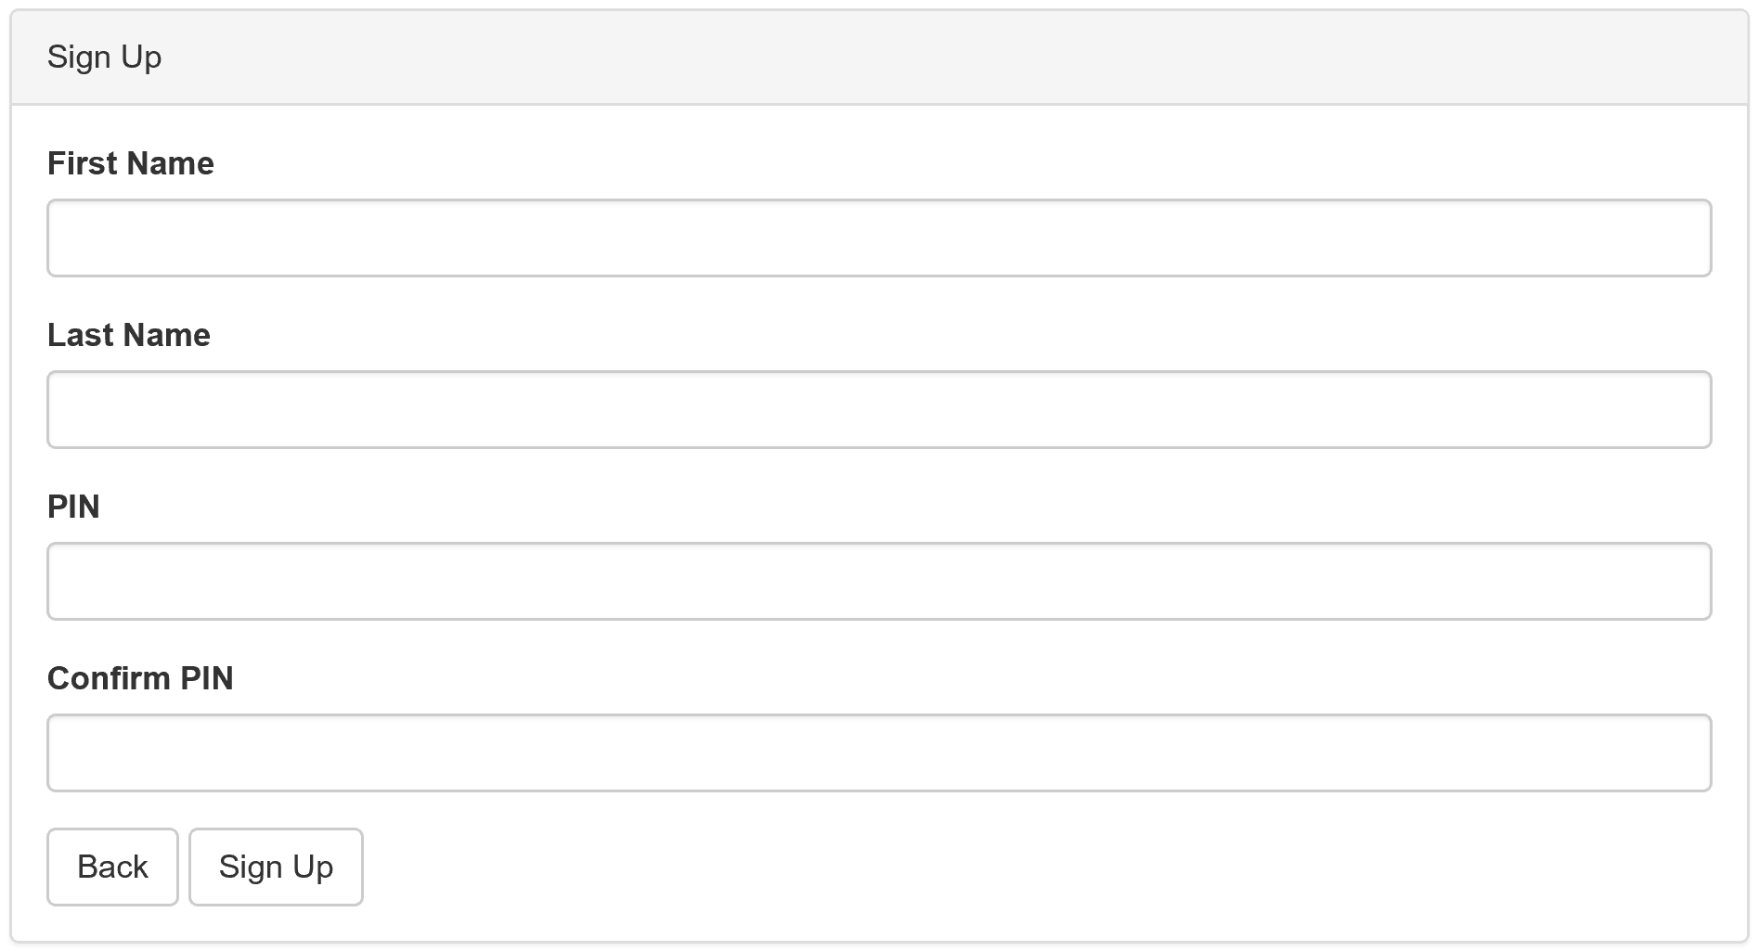
Sign Up Screen

Slide 7
Encryption Background
Symmetric-Key Encryption (e.g. AES)
Reversible
Useless in case of hacked DB
Hash function (e.g. RSA, Blowfish)
Irreversible
Reduce effectivity of brute force attacks
Blowfish is slower than RSA (this is good)
Add salt to protect against Rainbow Tables (pre-computed hashes)
Bcrypt
Easy Blowfish package for C#
Obtained with Nuget

Slide 8
Encryption and Security
Client
User inserts PIN
Client hashes the PIN using Blowfish algorithm (with salt)
Client sends [Hashed PIN + salt] to server
Server
Signup: Server stores [Hashed PIN + salt] in database.
Login: Server verifies Hashed PIN against value in database.

Slide 9
Database

Slide 10
Further Potential

